Slide 1
Do You Want To Be an Entrepreneur?

Slide 2
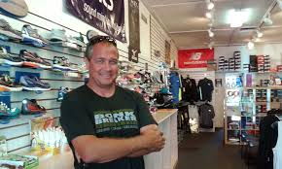
1. What It Takes
Starting your own business may sound exciting, but it is not something to take on lightly. Do some soul searching first to determine if it is the right path for you. Ask yourself if you are really cut out to be an entrepreneur.

Slide 3
So, what exactly is an entrepreneur? Well, one of the better definitions we've heard is: "someone who perceives an opportunity and creates an organization to pursue it."

Slide 4
There are many different ways to be an entrepreneur. You could develop a product or create a service. You could become an independent representative for someone else's company, selling or distributing their products. You could buy an existing business or franchise. You could even become an "intrapreneur," operating autonomously within a company.

Slide 5
What is it that motivates someone to start their own business? Many people become entrepreneurs because they want to create something of their own, to have a sense of personal achievement. Some view entrepreneurship as an opportunity to create substantial wealth. Others want to break out of the "corporate rat race" and be their own boss.

Slide 6
Being your own boss, however, has its downside. The most frequently cited disadvantage is the long hard hours, particularly during the start-up period. It takes a great amount of effort to get a business up and running. That means you may be working late into the night and every weekend for some time.

Slide 7
Needless to say there is financial risk associated with starting a business. Until the business takes off, your income may go up and down dramatically. In addition, you may have to invest some of your own savings and/or use your personal assets as collateral for business loans.

Slide 8
Running your own business is a tremendous responsibility. Your employees depend on you to provide stable employment. Your customers expect you to deliver on your promises. Your suppliers and bankers expect you to pay your bills. Your investors expect you to turn a decent profit. Are you the kind of person that can handle that kind of pressure?

Slide 9
Studies have identified a variety of personality characteristics associated with successful entrepreneurs. Among the most important are a healthy sense of self confidence and an optimistic attitude

Slide 10
Successful entrepreneurs take risks, but they are calculated risks. They don't plunge blindly into new situations. Instead, they are thorough and prepared.

Slide 11
2. How to Get Started
Before you can build a viable business, you need to know the essential steps in getting a company up and running.

Slide 12
The first step in starting a business is to identify an opportunity. Keep your eyes and ears open. Ask lots of questions. Look for unmet needs you could address through a new product or service.

Slide 13
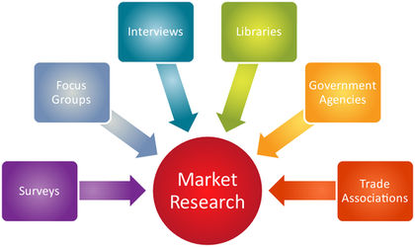
Don't jump into anything until you are sure the opportunity is real. Conduct market research to determine the true potential for your idea. Read everything you can in the area. Talk with your potential customers, as well as other professionals in the field. Questions to ask yourself include:
Is there a real market? Is it growing?
How much are customers willing to pay?
Who is my competition? How will I compete?
What barriers will I have to overcome?
What resources would I need to enter the market?

Slide 14
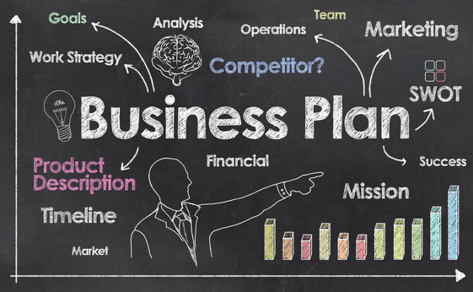
Next, develop a business plan. The process of writing things down will help you refine your thinking and will focus your efforts. A good business plan contains the following components:
Market analysis
Mission statement, long term goals, and specific objectives
Description of the product or service you are going to offer
Product development plan
Marketing strategies
Operations plan covering details such as
manufacturing, distribution, etc.
Financial plan ( including cash flow analysis)

Slide 15
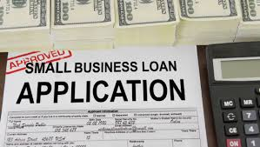
One of the biggest challenges for a start-up business is obtaining adequate financing. Among the possible sources of funding are your savings, friends and family, lending institutions and venture capitalists. All come with a cost. For example, you may be asked to put up your personal assets as collateral for a loan, and you will give up a portion of your future profits when you bring on investors. Consider the long-term impact of the alternatives before making any decisions.

Slide 16
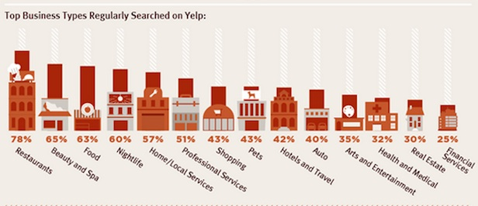
Before you open your doors, you will need to establish the legal status of your business. Your options include: sole proprietorship, partnership, limited partnership and corporation. You may also need certain licenses to operate your business. The Small Business Administration or an attorney can help you understand the legal issues.

Slide 17
There are endless decisions to make when you finally get down to setting up operations: what equipment to buy, where to locate your business, what business stationery to use, what policies and procedures to implement, etc., etc., etc. Take your time and think through your alternatives before making potentially costly choices.

Slide 18
During the start-up phase, you may not need any full time employees. Consider using outside contractors to handle the functions you don't have time or ability to do. When the time comes to start hiring, think carefully about who you bring into the business. Build your team with people who will really make a contribution.

Slide 19
It is crucial that you set up a good bookkeeping system. You will need to track revenue and expenses, manage cash flow and plan for taxes. Find someone who can advise you on the information needed and the best way to manage it.

Slide 20
Once everything is in place, how do you grow the business? The key to success is creative marketing and excellent customer service. Experiment with ways to reach potential customers. Then, keep them coming back by exceeding their expectations.

Slide 21
A few final thoughts for you budding entrepreneurs:
Get experience in the field before you break out on your own - you will have more credibility and will recognize the pitfalls to avoid.
Be realistic in your expectations - don't give up when things don't happen as quickly as you would like.
"Network" everywhere you go - you never know where you might find a new customer or a great new idea.

