Slide 1
Chp 5 Elements of a Contract
Capacity and Legality

Slide 2
Age guidelines….
A minor is 17 years, 363 days old
Age of “majority” legal adult starts at 17 years 364 (legal adult starts on the day before your 18th birthday).

Slide 3
Emancipation and Abandonment
Some states have declared that minors who are no longer under the control of their parents are emancipated.
This means they are responsible for their contracts.
A minor who marries or leaves home, giving up all rights to parental support, is considered emancipated and is said to have abandoned the protection afforded him or her as a minor.

Slide 4
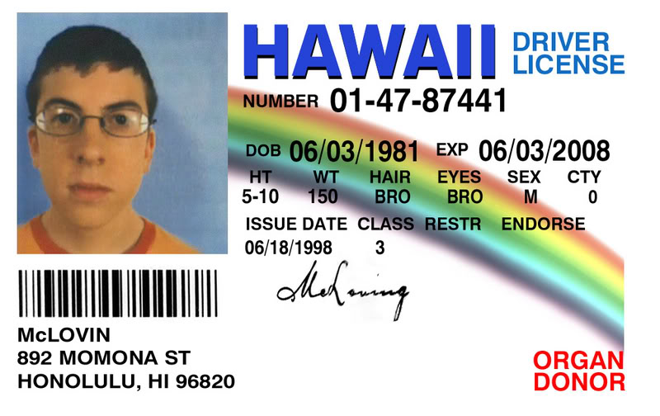
Misrepresentation of Age
If a minor claims to be over the age of majority, then he or she has committed fraud.
Fraud is a wrongful act, and minors are responsible for their wrongful acts.

Slide 5
Contracts of Minors
The law shields minors when they make contracts to protect them from unscrupulous adults. Minors may be vulnerable because of
Lack of education
Naïveté (Innocence)
Immaturity
Inexperience

Slide 6
Voidable Contracts
Contracts made by minors are voidable by the minor.
This means that minors may disaffirm, or avoid, their contracts if they so choose.

Slide 7
Voidable Contracts
To disaffirm a contract means to show the intent not to live up to the contract by a statement or some other act.
By permitting minors to have the privilege of disaffirming contracts, the law provides young people with a second chance when they use poor judgment.

Slide 8
Returning Goods
If a minor still has the merchandise he or she received upon entering a contract, this merchandise must be returned when the contract is disaffirmed.

Slide 9
Disaffirming the Whole Contract
A minor may not affirm parts of a contract that are favorable and disaffirm the unfavorable parts.
Disaffirming Contracts Made with Other Minors
When two minors enter into a contract with each other, both parties have the right to disaffirm the contract.

Slide 10
Ratification of Minors’ Contracts
After reaching the age of majority, a person can ratify, or approve, contracts made during minority.
Ratification: act of agreeing to go along with a contract that could have been avoided.

Slide 11
Contracts for Necessaries
A minor is held responsible for the fair value of necessaries.
Necessaries, or necessities, include food, clothing, shelter, and medical care.

Slide 12
Other Contractual Capacity Rules (for certain types of contracts)
Mentally impaired persons
Intoxicated persons – Alcohol / Drugs
Convicts – people convicted of a crime
Aliens – people who are living in this country but are citizens of another country
Enemy Aliens – foreign born person designated as such during time of war.

Slide 13
Contracts that must be in writing;
Pay someone else’s debt
Pay debt for someone who has died
More than one year to perform
Consideration of marriage
Sale of good (UCC) – typically for goods/services over $500
The sale of real property

Slide 14
Homework… (answer in complete sentences)
What does it mean to be a minor?
What rights do minors have regarding contracts?
What contracts are voidable by a minor?
How can a person ratify a contract made in minority?
Name two other classes of persons who are able to avoid contracts.

