Slide 1
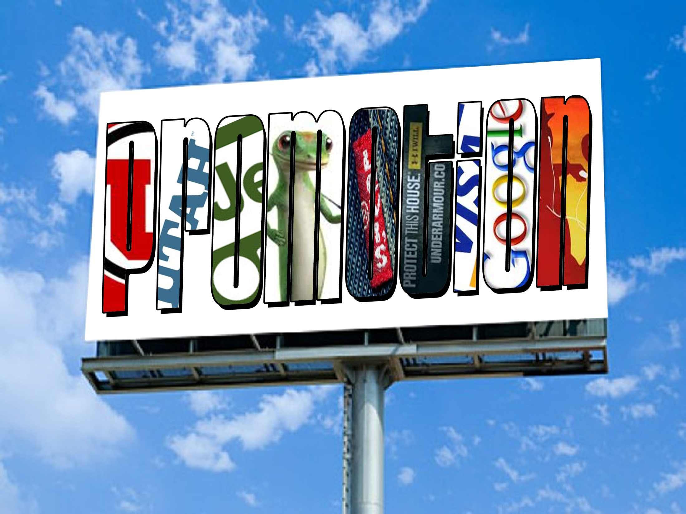
Standard 5

Slide 2
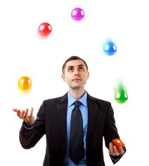
Standard Five
Students will discover the importance and elements used in developing a PROMOTION MIX to market sports businesses.

Slide 3
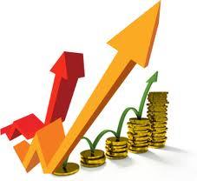
Promotion
A marketing function needed to communicate information about goods, services, images, and/or ideas to achieve a desired outcome.

Slide 4
Role of Promotion
Inform
Grand Opening
New Product
Updated Product (latest version)
Persuade
Why this product over the competition
Why this event rather than the other event
Remind
We are still here, and you know you want one.
Notes:
64

Slide 5
Promotional Goals
Increase Sales
Increase Awareness
Be Competitive
Reach the Target Market
Build Customer Relationship
Develop Image
Which one is Direct?

Slide 6
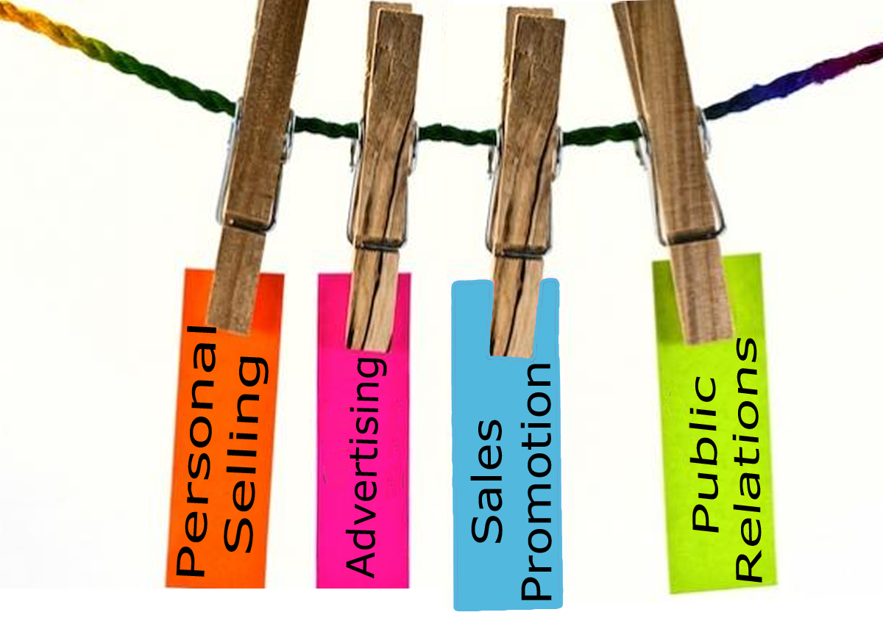
Promotional Mix
A combination of marketing communication channels that a business uses to send its messages to consumers.

Slide 7
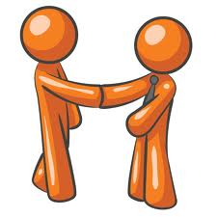
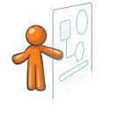
Personal Selling
The form of promotion that determines client needs and wants and responds though planned, personalized communication that influences purchase decisions and enhances future business opportunities.
Groups sales staff
Ticket agents
Salespeople
Telemarketers

Slide 8
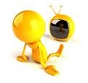
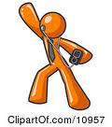
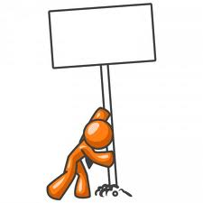
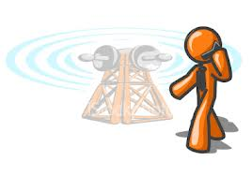
Advertising
Advertising: Any paid form of non-personal presentation of ideas, images, goods, or services.
Television
Radio
Newspaper
Magazines
Sponsorships
Outdoor
Product Placement
Social Media
Mobile Advertising

Slide 9
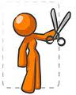
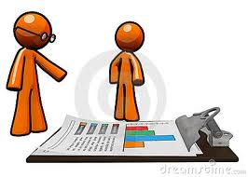
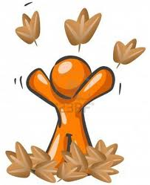
Sales Promotion
Marketing activities that are designed to create an immediate spike in sales
Coupons
Sales
Games
Contests
Give-a-ways
BOGOs
Bundling

Slide 10
Public Relations
Any non-personal presentation of ideas, goods, or services that is not paid for by the company or individual that benefits from or is harmed by it.
News releases
Press conferences
Television Show appearances
News features
Interviews

Slide 11
Media Types
The message channels used by a seller to promote a good, service, or idea
Broadcast Media
Print Media
Social Media
Direct Mail
Outdoor
Specialty Media
Other
Notes:
69
70
73

Slide 12
Advertising Schedule
Advertising Schedule: Schedule of promotional activities to be run prior to, during, and after an event.
Promotions are typically Run in a group or “Campaign”
Promotions typically have a common theme
Promotions typically use several media types
An advertising schedule organizes promotions & media types over a time period.

Slide 13
Ad Schedule
TIME
Television
Print
Print
Retailer Promotions
EVENT
Blimp
Radio
Internet
Social Media
Notes:
Internet needs to have social media (facebook, twitter…) added

Slide 14
Promotion Budgeting
1. Fund the Primary Promotion
“main” promotion, campaign, efforts
Primary focus for the company
2. Fund the secondary promotions
“extra” promotions
Typically run with retailers
Provide ways to spur sales
Provide ways to earn back costs
Expand exposure/reach of promotions

