Slide 1
Creating Sponsorships
3.2 Sponsorship Process

Slide 2
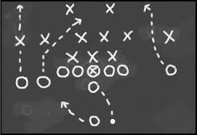
The Sponsorship Process
Sponsorship Goals
Sponsorship Budget
Sponsor Acquisition
Implementing
Evaluating

Slide 3
Goals of Sponsorship
Increase Sales
Increase Awareness
Be Competitive
Reach the Target Market
Build Customer Relationships
Develop Image
Which goal is DIRECT?

Slide 4
Sponsorship Budgeting
Involves funding the Primary Sponsorship & Promotions
Funding by same means as Promotion
Competitive Parity
Arbitrary Allocation
Percentage of Sales
Objective & Task

Slide 5
Budgeting Types
Competitive Parity
Base Promotions on Industry Leader’s Activities
“Follow The Leader”
Arbitrary Allocation
Budget by “What I Can Afford”
Usually determined by relationships

Slide 6
Budgeting Types
Percentage of Sales
Base Budget on Previous Year’s Sales Figures
Objective & Task
Set Goals of Sponsorship & Budget to meet goals

Slide 7
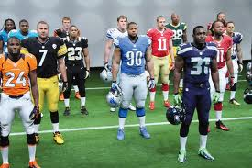
Funding Primary Sponsorship
Budgeting Considerations
The up-front money it costs a company to fund the sponsorship of a Sports Property
Negotiated
Often Multi-year contracts
5 year deal for $35 Million per year

Slide 8
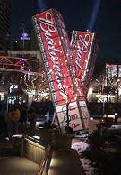
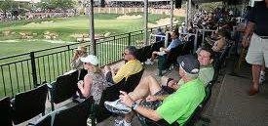
Funding the Promotions
Budgeting Considerations
Sponsor Leveraging:
Getting as much as possible from a sponsorship agreement
(example: BudWorld in 2002 Olympics)
Negotiation Items
Tickets
Hospitality packages
Signage / Exposure
Sales Opportunities
Product Placement
Naming Rights

Slide 9
Sponsor Acquisition
Find & Sponsor an Event which meets the Goals & Budget
Determine Scope
GLOBAL, INTERNATIONAL, NATIONAL
REGIONAL, LOCAL
Determine Athletic Platform
THE TEAM, EVENT, OR ATHLETE
Select by:
Budget & Feasibility of Platform
Geographic Scope
Sponsorship Goals

Slide 10
Implementing the Sponsorship
Operating a Leveraged Event
Sufficient Staffing
Sales Opportunities
Event Operations
Event Promotions
Activities & Ancillary Events
Responsibility of Implementation lies with both
the Sponsor and the Sports Property
Notes:
Teachers – make sure you define WHAT a leveraged event consists of for the promoter

Slide 11
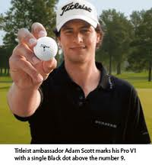
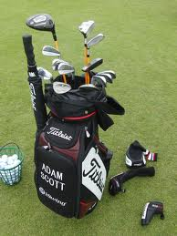
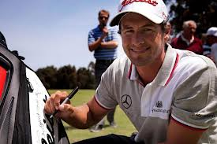
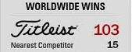
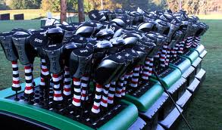
IMPLEMENTED
Operating a Leveraged Event
Sufficient Staffing
Sales Opportunities
Event Operations
Event Promotions
Activities & Ancillary Events
Notes:
Teachers – make sure you define WHAT a leveraged event consists of for the promoter

Slide 12
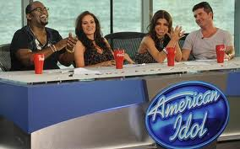
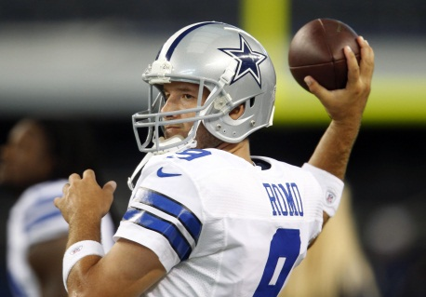
Evaluating the Sponsorship
Important factors for Sponsor Participation
Number of Media Mentions
Media Equivalencies
Advertising Dollar Value for Exposure
Sales Figures
Attitude Changes
Number of Distributors
Pre & Post Event Measurements

Slide 13
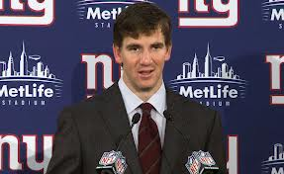
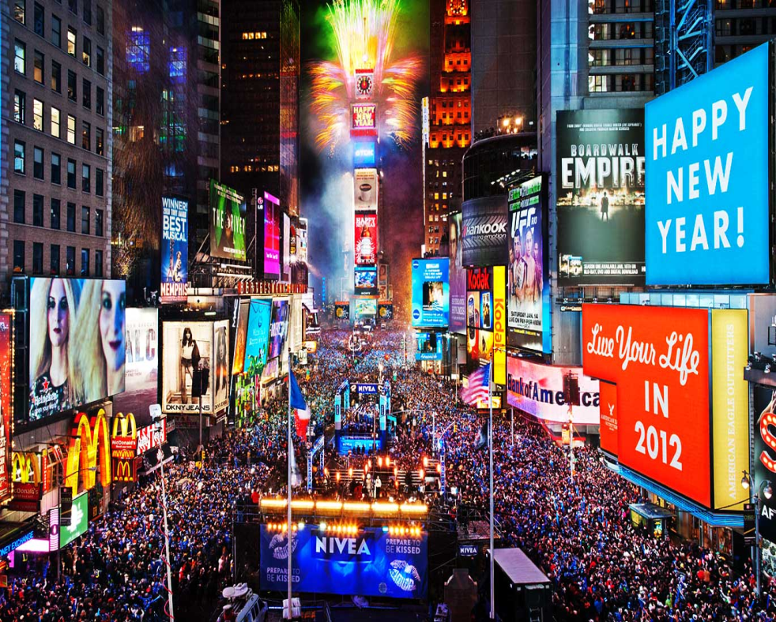
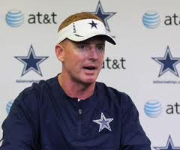
Drawbacks to Sponsorship
Becoming Common
Expensive
Clutter
Negative Publicity

Slide 14
Why Sponsors Fail
No Budget for Activation
Not Long Term
No Measurable Objectives
Overlook Ambush
Too Much Competition
Failure to Excite the Sales Chain
Insufficient Staffing
Buying at the Wrong Level
No Communications to Add Value

