Slide 1
ENTREPRENEURSHIP Unit 1.3
Students will explore entrepreneurial opportunities

Slide 2
Students will explore entrepreneurial opportunities
Students will be able to:
Compare risks and rewards of owning a business
Determine essential factors needed to choose type of business to start
Assess business opportunities and trends, both domestic and global (include new and existing ideas, franchises, and web-based enterprises)
Apply idea-generation methods
Determine feasibility of ideas
Outline available resources and government agencies to assist small business owners

Slide 3
Risks of Owning a Business
Working long hours
Having an uncertain income
Being fully responsible
Risking one’s investment

Slide 4
Rewards of Owning a Business
Being your own boss
Doing something you enjoy
Having the opportunity to be creative
Freedom to set your own schedule
Controlling your salary
Contributing to the community

Slide 5
Types of Businesses
Start your own business
Purchase a franchise business
Buy a new or existing business
Web-based business

Slide 6
Start Your Own Business
Advantages
Make all the decisions about everything
Completely independent
Disadvantages
No certainty that customers will purchase what you offer
Difficult to start a new business

Slide 7
Purchase an Existing Business
Advantages
Already has customers, suppliers and procedures
May train the new owner
Prior records of revenues, expenses, and profits
Financial arrangements can be easier
Disadvantages
May be for sale because not making money
Serious problems may be inherited
Capital is required

Slide 8
Franchise Ownership
Franchise: Legal agreement that gives an individual the right to market a company’s products or services in a particular area.
Advantages
Provided with an established product or service
Offer management, technical, and other assistance
Equipment and supplies can be less expensive
Guarantee of consistency attracts customers
Disadvantages
Can cost a lot of money and cut down on profits
Owners of franchises have less freedom to make decisions than other entrepreneurs
Franchises are dependent on the performance of other franchisees in the chain
The franchisor can terminate the franchise agreement

Slide 9
Franchise Opportunities
Industries to Choose from:
Examples of Franchises:
Advertising
Automotive
Buisness Services
Child Related
Cleaning
Computer / Internet
Foods
Financial Services
Health & Fitness
Pets / Animals
Retail
Sports & Recreation
Senior Care
Travel
Vending
Gender Specific
Foods Industry:
Pizza Hut
Baskin-Robins
Carl’s Junior
Wendy’s
McDonalds
Subway
Can you think of some other franchises in different industries??

Slide 10
New and Existing Ideas
Enter the Family Business
Advantages are:
Trust and togetherness
Great potential for success
Disadvantages are:
Only 1/3 of family businesses survive after the 2nd generation
Never get away and take time off
Buy a Business that’s for Sale
Advantages are:
Experienced employees
Substantial inventory and trade credit
Has a location
Disadvantages are:
Business may be for sale because it is not successful

Slide 11
Business Opportunities and Trends
Home-based Businesses
Businesses related to:
Technology
Fitness and Health
Indulgence Goods
Ethnic Products
Outsourcing
Strategic Alliances

Slide 12
Global and Domestic Business
Global
A business that sells its product in more than one country.
Importing: Buying goods from other countries to sell in their own country.
Exporting: Selling and shipping goods to another country.
Domestic
A business that sells its product in its own country.

Slide 13
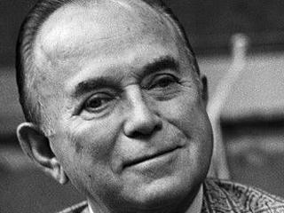
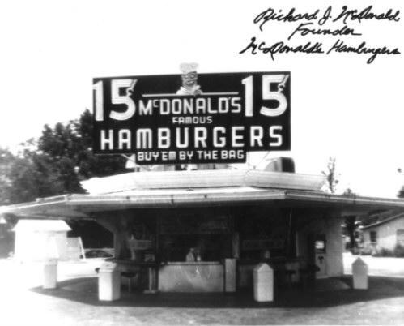
Purchasing an Existing Business
Ray Kroc of McDonalds purchased a hamburger stand from the McDonalds brothers
Ray Kroc
McDonald’s Brothers

Slide 14
Web-based Enterprises
Businesses that generate their revenue directly from their website fall into the web-based business category
The following are web-based enterprises:
E-bay
Monster
Amazon

Slide 15
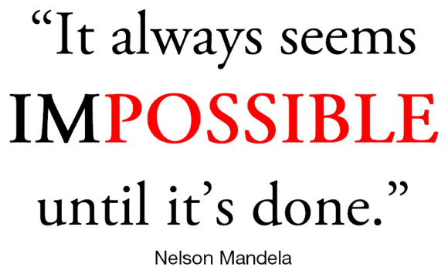
Creativity
Whatever type of business you choose to do, you must think creatively about every aspect of your business

Slide 16
Idea-generation Methods
Technology resources can help you examine different opportunities
Small Business Administration (SBA) is a government organization that exists to help small businesses and their owners
Talk to entrepreneurs and attend trade shows
Start “people watching”
Watch for demographic changes
Find way to improve current products or services

Slide 17
Feasibility of Ideas
Once you’ve got an idea for your new business, you need to turn it into a business concept
Business Concept: Idea for a new business that can be tested.
What is the product or service being offered?
Who is the customer?
What is the benefit you are providing?
How will you get the product or service to the customer?

Slide 18
Feasibility of Ideas
Feasibility Analysis: The process used to test a business concept
Are there customers who want what you have to offer?
What conditions must be present for you to decide to go forward with the business?
The analysis will show if there is enough demand for your product or service.

Slide 19
Feasibility of Ideas
Ways of testing the business concept in the market are:
Testing product or service requirements
Talking to customers
Studying the competition
Research and fact finding will help you determine a business idea’s potential and profitability.

Slide 20
Available Resources to Assist Small Business Owners
Friends and Family
Local and Municipal Government
State Government

Slide 21
Available Government Agencies to Assist Small Business Owners
SBA-Small Business Administration
Federal government agency whose purpose is to help small businesses. They provide management and technical advice to owners or prospective owners of small businesses. They also guarantee loans made by commercial banks. This means that the SBA agree to pay the bank loan if you cannot. The SBA will guarantee up to 90% of a bank loan.
Chamber of Commerce
State Governments

Slide 22
Let’s Review
Compare risks and rewards of owning a business
Determine essential factors needed to choose type of business to start
Assess business opportunities and trends, both domestic and global (include new and existing ideas, franchises, and web-based enterprises)
Apply idea-generation methods
Determine feasibility of ideas
Outline available resources and government agencies to assist small business owners

