Slide 1
Sports Marketing
Standard 1.2
Marketing Of Sports

Slide 2
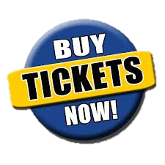
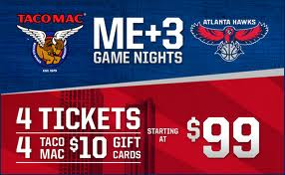
Objective Two
Identify reasons a sports property would utilize marketing

Slide 3
What IS Sports Marketing
Sports Marketing is the application of marketing principles to sports properties and to non-sports products using sports.
Simply:
Sports Marketing is the Marketing of Sports
Sports Marketing is Marketing Through Sports
Notes:
1

Slide 4
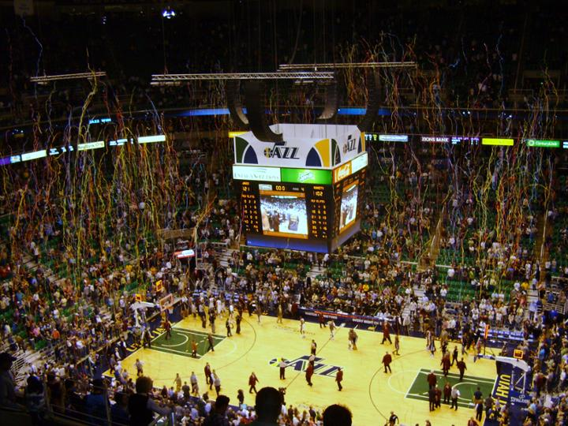
Marketing OF Sports
Applying marketing Principles to the marketing of a “Sports Property”
Sports Properties:
League - Team
Athlete - Stadium
Program - Events
Competition - Contests
Notes:
10. 11

Slide 5
Marketing OF Sports
Athletes
Agents
Ticket Sales Representative
Ticket Collection
Marketing Writers
Sports Journalist
Parking
Merchandise Vendor
Director of Marketing
Sponsorship Sales Executive
Director of Communications
Security
Maintenance
Concessions
Sports Announcer
Notes:
Agents #21

Slide 6
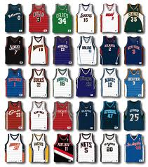
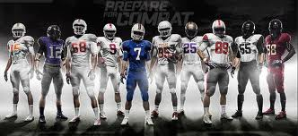
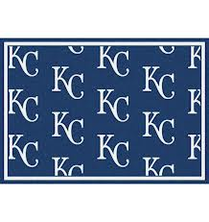
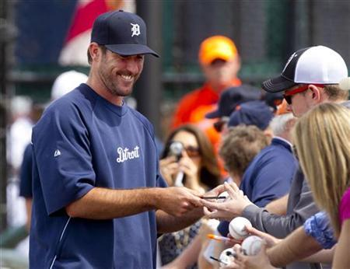
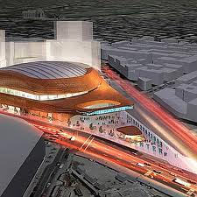
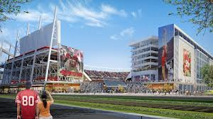
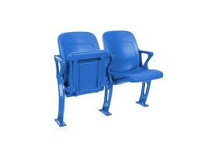
Marketing of SPORTS

Slide 7
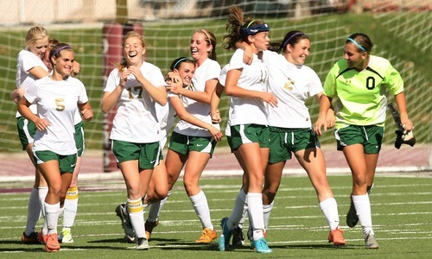
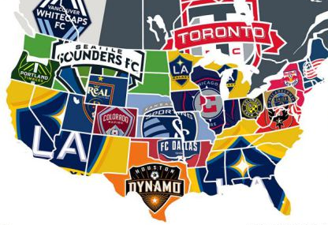
The Growth of Soccer

Slide 8
Sports Marketing
Standard 1.3
Marketing Through Sports

Slide 9
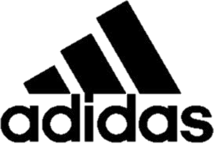
Objective Three
Identify reasons a company would utilize sports marketing.

Slide 10
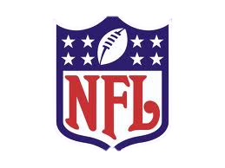
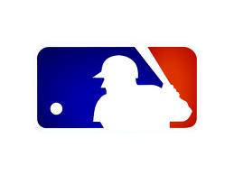
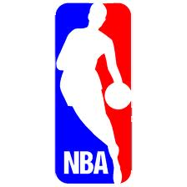
Marketing THROUGH Sports
Marketing of Non-Sports products or services using sports as a media
Using a team or event for marketing
Notes:
12

Slide 11
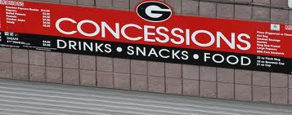
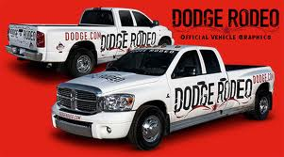
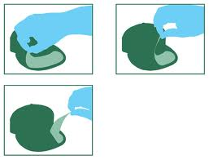
What is Marketed at Sports Events?
Sponsor products or services
Traded products or services
Public Service Announcements (Ideas)

Slide 12
Borrowed Equity
Where a sponsor utilizes the appeal and draw of an existing event to develop an image for its products or services with the audience
Within Audience & Through Broadcast
Increase Sales
Increase Awareness
Be More Competitive
Reach the Target Market
Build Relationships
Develop a Corporate Image
Notes:
13

Slide 13
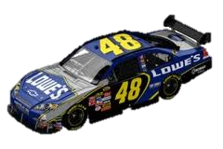
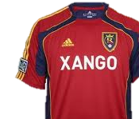
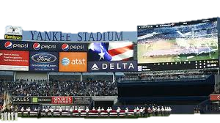
Marketing Through Sports

